Slide 1
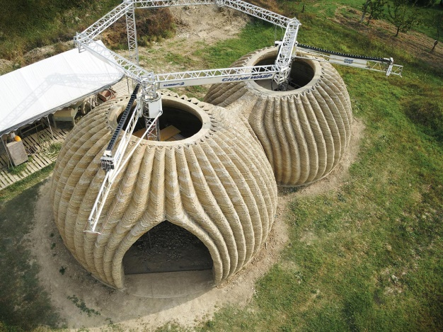
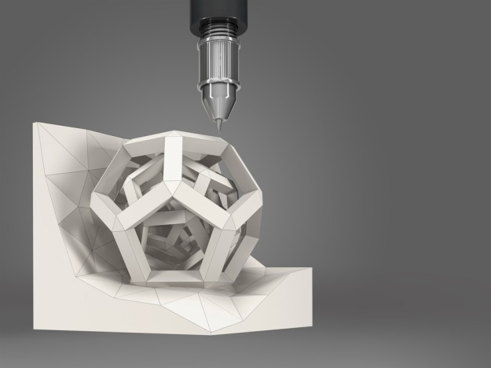

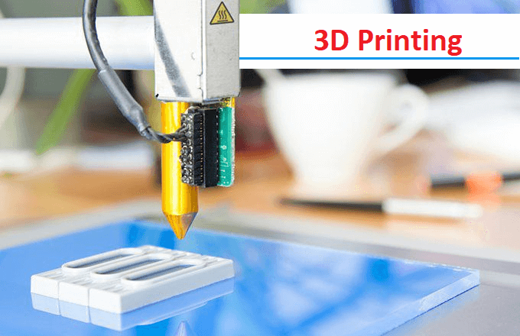
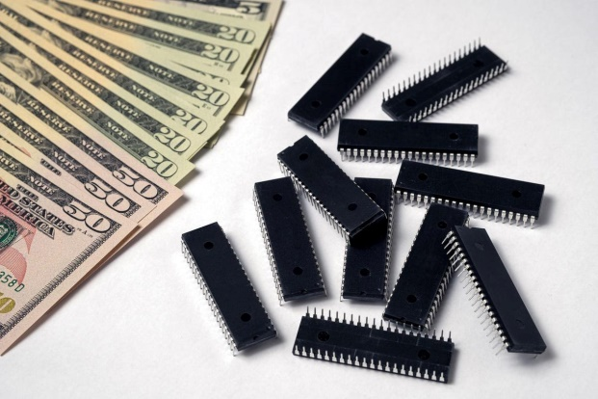
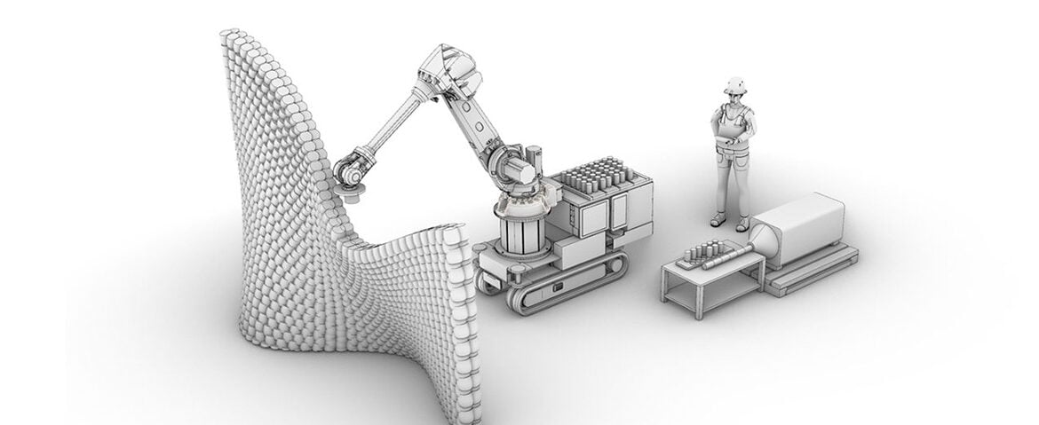
Unit-5
Introduction to Digital Fabrication

Slide 2
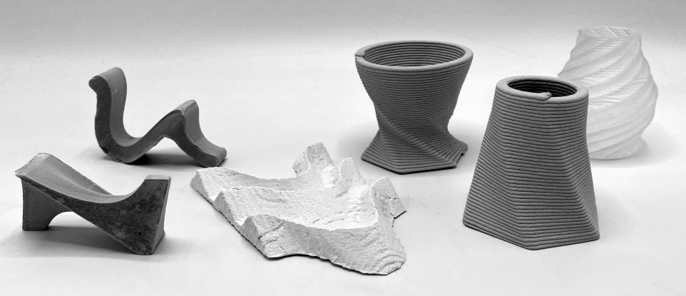
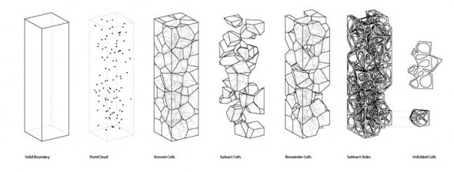
CONTENTS:
Need of digital manufacturing,
Prototype,
Types and roles of prototypes,
Rapid prototyping (RPT),
Phases of RPT,
Fundamentals of RPT and advantages

Slide 3
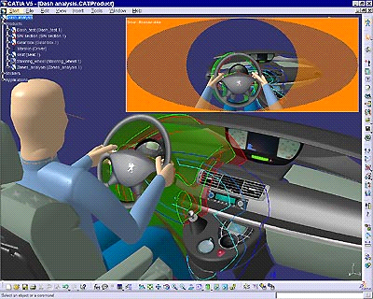
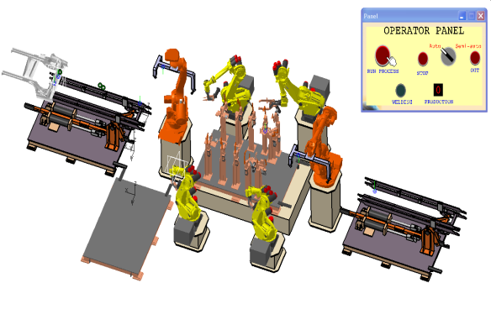
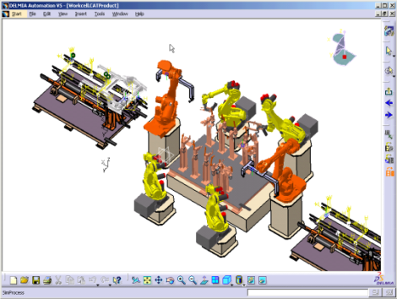
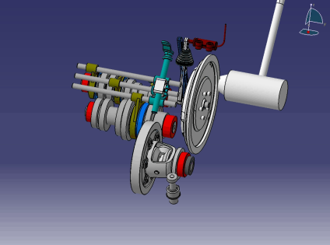
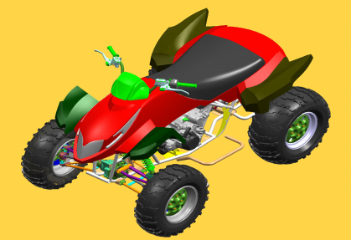
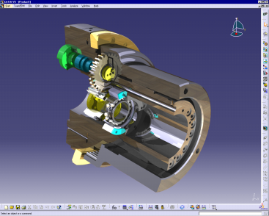

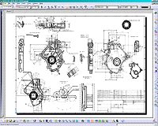
Evolution of the Design/Build Process
Knowledge
Capture
Design & Validation of Manufacturing Processes
Digital Mockup
Digital Manufacturing
Technological Advance
3D
2D
Integration of Product Design and Production Process Design
80s
90s
2000
2006…..

Slide 4
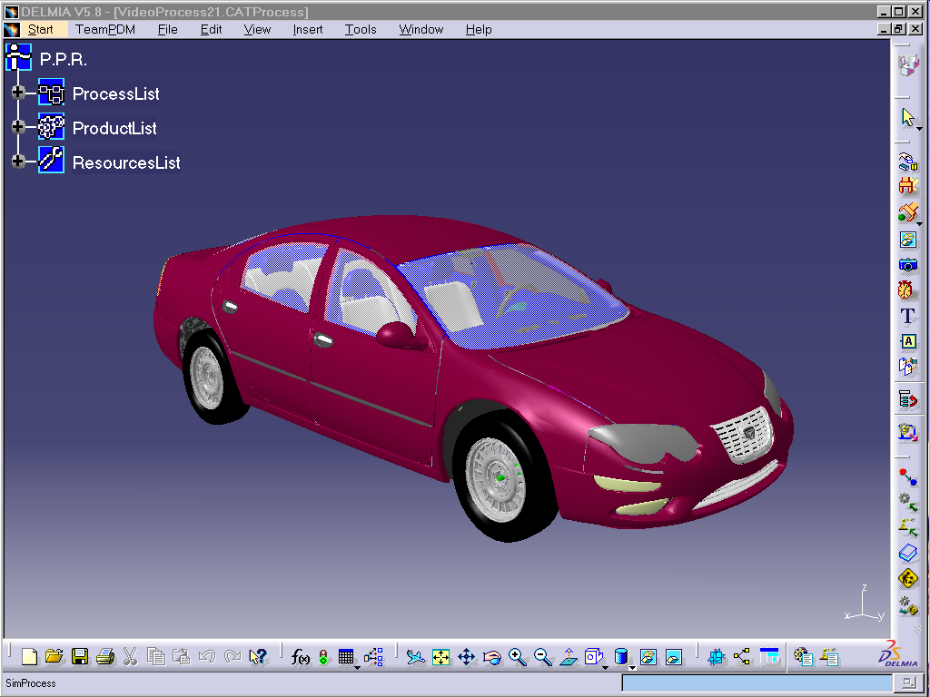
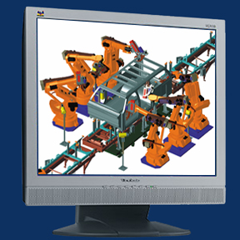
What is Digital Fabrication?
“Digital Manufacturing represents an integrated suite of PLM tools that supports manufacturing process design, tool design, plant layout, and visualization through powerful virtual simulation tools that allow the manufacturing engineer to validate and optimize the manufacturing processes. “
https://www.youtube.com/watch?v=s4HPs-aXOe4
Notes:
So just what is Digital Mfg? ARC defines Digital Mfg as: (read definition)
Here a robotic welding cell is defined virtually and then can be placed within the virtually defined production line. Production systems like this can be components of an entire virtual factory layout.

Slide 5
What Does Digital Fabrication Do?
Manufacturing Planning
Define Manufacturing Processes
Process Planning (Assembly & Installation)
Define Work Instructions & Work Flow
Detailed Process Design & Analysis
Detailed Resource Modeling & Simulation
Process Definition and Validation
3-D Factory Layout
Equipment, Tool & Fixture Simulation
Ergonomic Simulation
Validation & Virtual Commissioning
Control Logic Validation
Kinematic (Robotic) Validation
Quality Assurance/Process Improvement Validation
Sensor/Metrology Placement Validation
Virtual Commissioning/Validation of Automation Systems
Knowing that the Production System Works Prior to Launch: Priceless.

Slide 6
Digital Fabrication Redefines Concurrent Engineering
Product Design (CAD) tools are employed to define “What" is to be built,
Manufacturing Process design tools are used to define “How" it is to be built.
Integration of Product & Process Design directly supports the concept of Concurrent Engineering
Digital Manufacturing facilitates the Holistic view of Product and Process Design as integral components of the overall product life cycle

Slide 7
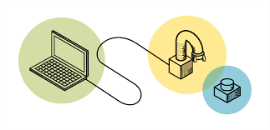
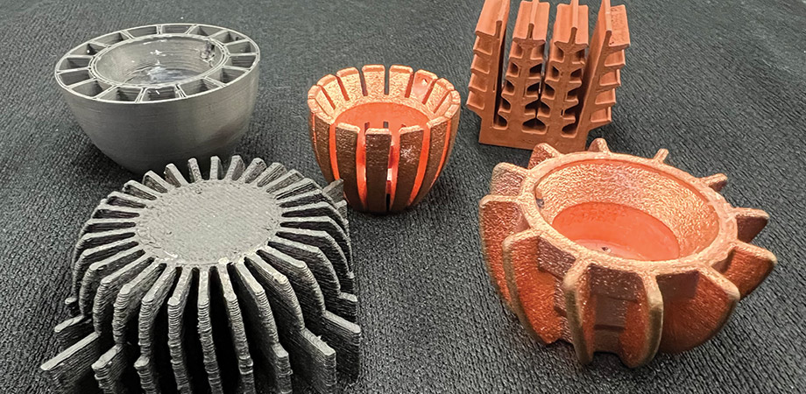
Introduction- DIGITAL FABRICATION
Digital fabrication is a design and manufacturing workflow, where digital data directly drives manufacturing equipment to form various part geometries,
This data most often comes from CAD (Computer-Aided Design), which is then transferred to CAM (Computer-Aided Manufacturing) software,
The output of CAM software is data that directs a specific additive and subtractive manufacturing tool, such as a 3D printer or CNC milling machine.
https://www.youtube.com/watch?v=ptDJw98Ds9M

Slide 8
Introduction- DIGITAL FABRICATION
Digital fabrication is a design and manufacturing workflow, where digital data directly drives manufacturing equipment to form various part geometries,
This data most often comes from CAD (Computer-Aided Design), which is then transferred to CAM (Computer-Aided Manufacturing) software,
The output of CAM software is data that directs a specific additive and subtractive manufacturing tool, such as a 3D printer or CNC milling machine.

Slide 9
Need of Digital Manufacturing
Market Competition- The competition in the world market for new manufactured products has intensified tremendously,
Swift Production- For fast production, the processes involved in the design, test, manufacture have been squeezed, both in terms of time and material resources,
Keep it in-house – With a 3D printer and the right software, you can produce small batches of products on your own premises without the need for external vendors,
Save money – Because you’re only making prototypes or small batches of a product, you won’t need much storage space. You can also save money on materials by using lower-grade supplies or even recycled plastic,
Save time – Digital fabrication accelerates the process of product development as you can create prototypes much more quickly than traditional manufacturing methods, with no need to outsource
Spot errors early – Engineers like digital fabrication because it helps them spot any issues that exist within days rather than months,

Slide 10
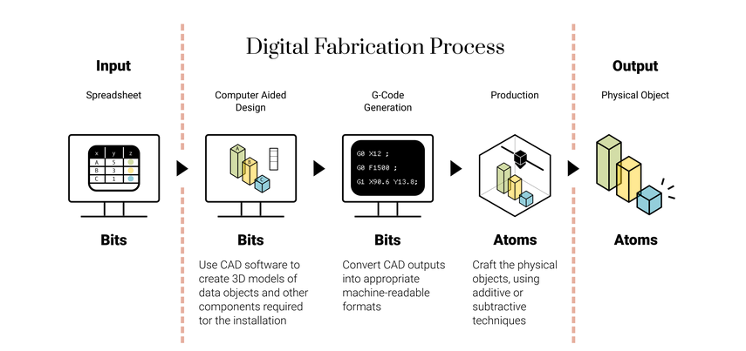
DIGITAL FABRICATION PROCESS

Slide 11

Video
https://www.youtube.com/watch?v=s4HPs-aXOe4

Slide 12
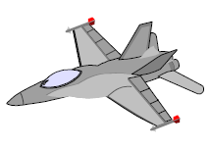
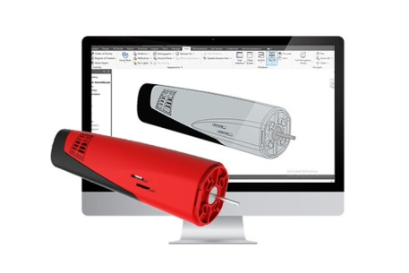
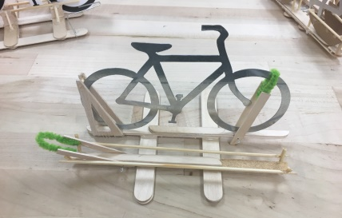
Prototype
According to Oxford Dictionary, a ‘prototype’ is the first or original example of something that has been or will be copied or developed; it is a model or preliminary version;
e.g.: A prototype supersonic aircraft.
Another definition- An approximation of a product (or system) or its components
in some form for a definite purpose in its implementation,
https://www.youtube.com/watch?v=8Ome0BKLgqQ&t=47s
https://www.youtube.com/watch?v=WZpv4eBcHik
Prototyping is the process of realizing these prototypes.

Slide 13

Prototype
A prototype is the first or original example of something that has been or will be copied or developed; it is a model or preliminary version.

Slide 14
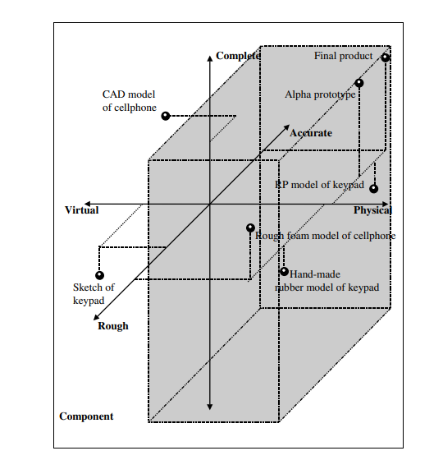
Types of Prototypes
There are three aspects of interests:
Implementation - from the entire product to its sub-assemblies/ components,
Form - from a virtual (nontangible) prototype to a physical (tangible) prototype, and
Degree of the approximation- from a very rough representation to an exact replication of the product.
Examples:
Virtual prototypes: Mathematical models, control systems, visualization of airflow over an aircraft wing to ascertain lift and drag on the wing during supersonic flight. Drawbacks- Couldn’t predict any unexpected phenomena,
Physical prototypes: Mock-up of cellular mobiles,
Rough prototypes: Foam models- to see the dimensions and general forms,
Exact replication: Pre-production models
Types of prototypes described along the three aspects of implementation, form and approximation

Slide 15
Roles of the Prototypes
The roles of prototypes in the product development process are shown in Figure:
Experimentation and Learning
Testing and Proofing
Communication and Interaction
Synthesis and Integration
Scheduling and Makers
Experimentation and learning- Prototypes can be used to help the thinking, planning, experimenting and learning processes whilst designing the product.
Testing and Proofing - Eg., in the early design of folding reading glasses for the elderly, concepts and ideas of folding mechanism can be tested by building rough physical prototypes,
Communication and Interaction - Protypes not just convey the information within the product development team, but also to management and clients,
Synthesis and Integration - A prototype can also be used to synthesize the entire product concept by bringing the various components and sub-assemblies together to ensure that they will work together,
Scheduling and Makers - Prototyping helps in the scheduling of the product development process and is usually used as markers for the start or end of the various phases of the development effort.

Slide 16
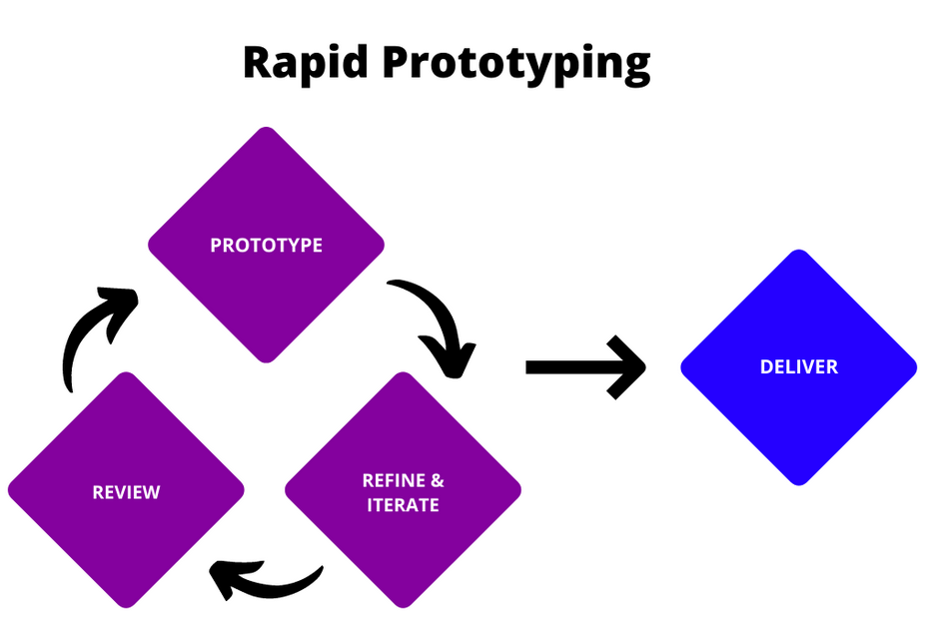
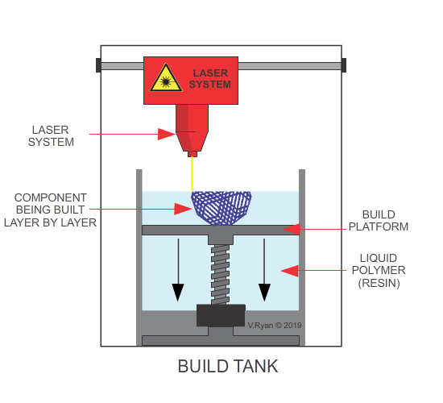
Rapid Prototyping
Rapid prototyping is a group of techniques used to quickly fabricate a scale model of a physical part or assembly using three-dimensional computer aided design data,
“As the name implies, rapid prototyping is a process of creating a prototype rapidly to evaluate the features or some part of the product.”
https://www.youtube.com/watch?v=OhNnKTaciVI
https://www.youtube.com/watch?v=3KcK_-fY_OI&t=22s
The first Rapid prototyping method, called stereolithography, was developed in the late 1980s, but more sophisticated techniques are available these days,
The term ‘rapid’ is relative. Some prototypes may take hours or days to build,
https://www.youtube.com/watch?v=faGyF81LadA

Slide 17
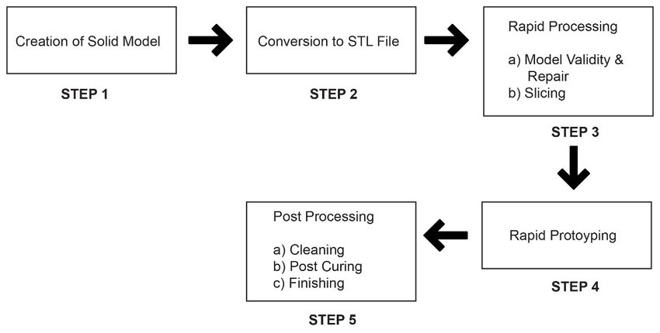
Rapid Prototyping
Rapid prototyping is a additive manufacturing process, that works on the basic principle of producing a 3D part by building and stacking 2D layers together,
Most common types of Rapid Prototyping systems are:
(a) SLA – Stereolithography,
(b) SLS – Selective Laser Sintering,
(c) LOM – Laminated Object Manufacturing,
(d) FDM – Fused Deposition Modeling
Although these are different techniques, but their basic principles are same.

Slide 18
Rapid Prototyping Process
Fabricate the model
Building the model layer by layer
Forming a 3D model by solidification of liquid/ powder
Removing support structure and cleaning
After building, drain out extra material,
Cut out the prototype,
Cut out unnecessary support material
Post Processing
Includes surface finishing and other processes

Slide 19
Phases of Rapid Prototyping
Phase 1
Manual Prototyping
Phase 2
Soft or Virtual Prototyping
Phase 3
Rapid Prototyping

Slide 20
Phases of Rapid Prototyping
Prototyping processes have gone through three phases of development:
First Phase: Manual Prototyping-
In this early phase, prototypes are not very sophisticated,
Fabrication of prototypes takes on average about four weeks, depending on the level of complexity,
The techniques used in making these prototypes tend to be craft-based and are usually extremely labor intensive.
Second Phase: Soft or Virtual Prototyping-
Computer models can be stressed, tested, analyzed and modified as if they were physical prototypes,
Eg., analysis of stress and strain can be accurately predicted on the product,
With such tools on the computer, several iterations of designs can be easily carried out by changing the parameters of the computer models.
Third Phase: Rapid Prototyping-
It includes tremendous time savings, especially for complicated models.

Slide 21
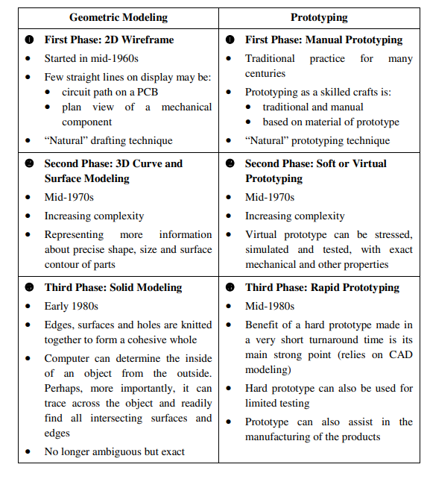
Geometric Modeling and Prototyping

Slide 22
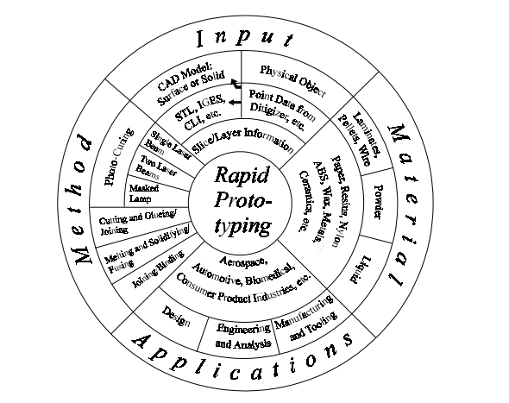
Fundamentals of Rapid Prototyping
Rapid Prototyping
Input
Method
Material
Application
The Rapid Prototyping Wheel depicting
the four major aspects of RP

Slide 23
Advantages of Rapid Prototyping
Advantages of Rapid Prototyping
Direct Benefits
Benefits to Product Designers
Benefits to tooling and Manufacturing Engg
Indirect Benefits
Benefits to Marketers
Benefits to Consumers

Slide 24
Advantages of Rapid Prototyping
Design Applications-
Designers can confirm their designs by building a real physical model in minimum time using RP,
Design Benefits-
Reduced lead times to produce prototypes,
Improved ability to visualize the part geometry,
Early detection of design errors,
Engineering Analysis and Design-
Comparison of different shapes and styles to determine aesthetic appeal,
Stress analysis of physical models,
Fabrication of pre-production parts for process planning and tool design

Slide 25
Advantages of Rapid Prototyping
Process is Fast and accurate,
Superior surface finish,
Separate materials can be used for components and supports,
No need to design jigs and fixtures,
No need of moulds and other tools,
Harder materials can be easily used,
Minimum materials wastage,
Reduces product development cycle time considerably

Slide 26
Limitations of Rapid Prototyping
Many times component gets distorted,
Limited range of materials,
Operation cost

Slide 27
Thanks

